Slide 1









My Linear Equations Interactive Notebook
$$×$$
$$\frac{1}{2}$$
$$÷$$
$$+$$
$$−$$
$$\frac{3}{5}$$
$$7$$
Name
Class
Teacher
Term 1 Semester 1
$$5^{2}$$
$$\sqrt{9}$$
1

Slide 2
Contents
Glossary or Formula Page
Page
Date
Description
2
3

Slide 3
Tasks
24
7
30
Essential Question
Questions
Notes
Summary
6
7

Slide 4
24
7
30
Date
Simultaneous Equations
EQ – How do I find the point of intersection by Substitution?
7

Slide 5
24
7
30
Date
Simultaneous Equations
EQ – How do I find the point of intersection by Substitution?
When you use the substitution method you use one equation to express one variable in terms of the other. Then you substitute this into the other equation to make a linear equation in one variable.
Solve this pair of simultaneous equations by substitution.
2b – a = 3 [1]
a + 3b = 7 [2]
Rewrite equation 1 like this a = 2b – 3
Substitute this changed equation 1 into where a is in equation 2
(2b – 3) + 3b = 7
2b – 3 + 3b = 7
5b = 7 + 3
5b = 10
b = 2
Now substitute b = 2 into equation 1
a = 2*(2) – 3
a = 1
∴ a = 1 and b = 2 or written as (1,2)
Substitute?
Where a is put 2b – 3
7

Slide 6
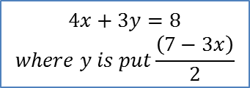
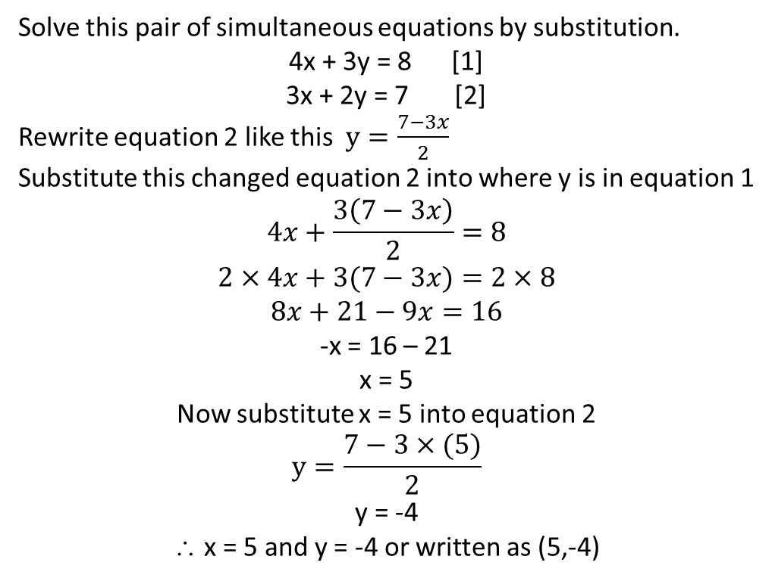
24
7
30
Date
Simultaneous Equations
EQ – How do I find the point of intersection by Substitution?
Substitute again a bit harder
Solve this pair of simultaneous equations by substitution.
4x + 3y = 8 [1]
3x + 2y = 7 [2]
Rewrite equation 2 like this $y=\frac{7−3x}{2}$
Substitute this changed equation 2 into where y is in equation 1
$$4x+\frac{3\left(7−3x\right)}{2}=8$$
$$2×4x+3(7−3x)=2×8$$
$$8x+21−9x=16$$
-x = 16 – 21
x = 5
Now substitute x = 5 into equation 2
$$y=\frac{7−3×(5)}{2}$$
y = -4
∴ x = 5 and y = -4 or written as (5,-4)
$$4x+3y=8$$
$$where y is put\frac{\left(7−3x\right)}{2}$$
7

Slide 7
24
7
30
Date
Simultaneous Equations
EQ – How do I find the point of intersection by Substitution?
7

Slide 8
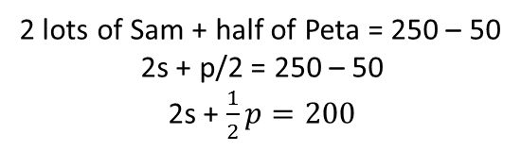
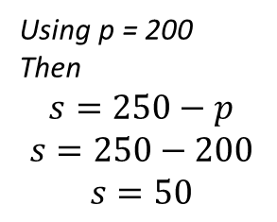
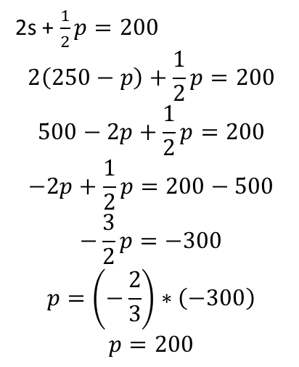
24
7
30
Date
Simultaneous Equations
EQ – How do I find the point of intersection by Substitution?
Two workers laid 250 bricks.
If Sam had laid twice as many as he did and Peta had laid half as many as she did, there would have been 50 bricks left over. How many bricks did each lay?
Problem Solving!
2s + $\frac{1}{2}p=200$
$$2\left(250−p\right)+\frac{1}{2}p=200$$
$$500−2p+\frac{1}{2}p=200$$
$$−2p+\frac{1}{2}p=200−500$$
$$−\frac{3}{2}p=−300$$
$$p=\left(−\frac{2}{3}\right)∗\left(−300\right)$$
$$p=200$$
Sam + Peta = 250
s + p = 250
s = 250 - p
Put s = 250 – p into this equation
Using p = 200
Then
$$s=250−p$$
$$s=250−200$$
$$s=50$$
2 lots of Sam + half of Peta = 250 – 50
2s + p/2 = 250 – 50
2s + $\frac{1}{2}p=200$
We have Sam laid 50 bricks and Peta laid 200.
7

Slide 9
Exercises
Exercise 2.7 from Dwyer
All to be done with a smile on your faces.

Slide 10
Notes Review
24, 7 ,30
Date
Title
Essential question
Notes complete
Notes complete with colour and diagrams
Questions completed
Contents page filed in
Formula page filled in

Slide 11
Homework
Review your notes and write a summary answering the essential question.

